Slide 1



If you don’t already have a
Google account, please create
one and log into it.
Nancy Darling
William and Jeannette Smith Professor of Psychology
Oberlin College Oberlin, OH US
This work was supported by the National Science Foundation
(NSF Grant Number 0939153) with special thanks to Ian Burns

Slide 2

Time Line: Black Holes
1790: Existence of Black Holes first theorized
1914: Einstein’s theory of relativity predicts specific characteristics of Black Holes
1914-1990: Mathematical models of black holes led to important advances in theoretical and applied physics
  What would Black Holes look like and how would we know if we found one?
1990s: Evidence for existence of Black Holes begins to accumulate
Present: Accumulating evidence refined and validated theories

Slide 3
Statistical & Computational Modeling: Complimentary Methodologies
Statistical Modeling
Theoretical model used to generate hypotheses and predictions
Data gathered based on observations and theory
Mathematical model creates a parsimonious summary of data
Analyze fit of model for consistency with predictions made from theory
Refine theory to better fit data
Computational Modeling
Theoretical model used to generate hypotheses and predictions
Mathematical model of theoretical model developed
Model simulations run under different conditions
Mathematical and theoretical model refined to better fit (a) expectations of theory and (b) observed data

Slide 4
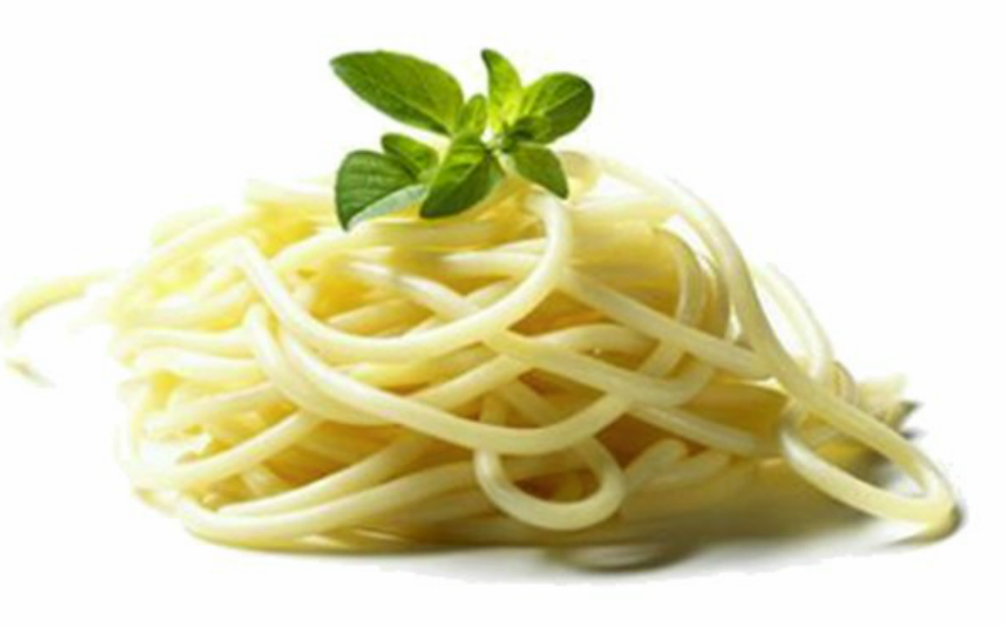
Why should we be interested in computational modeling?
Development is “best . . . studied as a variable process in which individual differences in cognitive, social, emotional, language, neurobiological and physical maturation, environment, life experiences, and genetics interact in complex ways” (NICHD, 2015).
And when we talk about dyads and families, those processes interact and modulate teach other as they unfold over time.

Slide 5
What we believe: Development* is the result of individual patterning of co-existing and self-reinforcing processes and behaviors
Individual, dyadic, or systemic change over time
How we usually test those models:
  Linear: often with unlimited growth
  Non-reciprocal
  Assume that within person change can be inferred from between person change (ergodicity)
  Assume statistical independence of processes we know are not
Our theories are much richer than our models
  Can computational modeling help?

Slide 6
Oberlin Modeling Initiative (OMnI)
NSF funded program to introduce dynamic systems thinking across the curriculum
  How do you think about complex problems where key elements interact and feed back into each other?
Nova was a natural outgrowth:
  Portable across different disciplines
  Goal was to teach dynamic systems thinking not programming

Slide 7
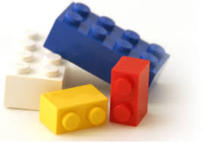
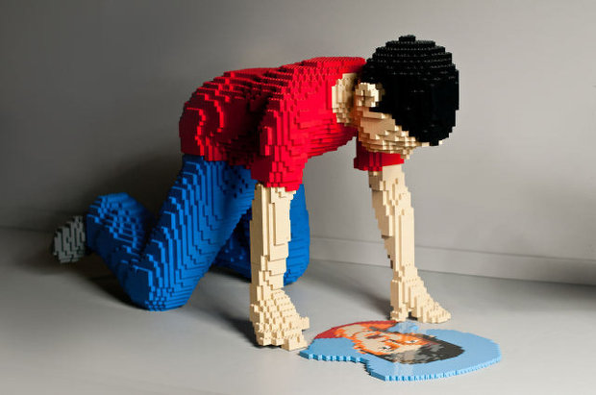
Nova concept
Flexible modeling platform suitable for student exercises but powerful enough for serious research applications
Capable of a full range of dynamic systems models
  Stock and flow
  Spatial
  Agent based
Multi-platform
Free!

Slide 8
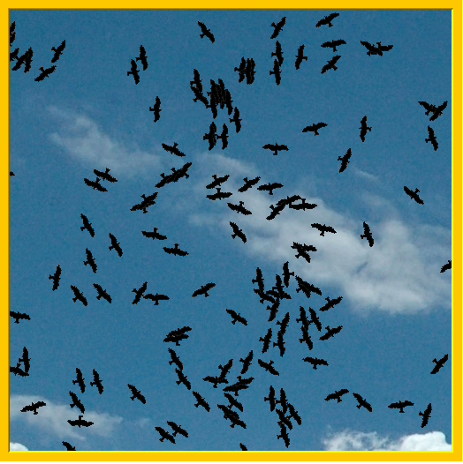
Nova: A Java-based platform that operates at multiple levels
Agent based and spatial modeling on a stock & flow core

Slide 9
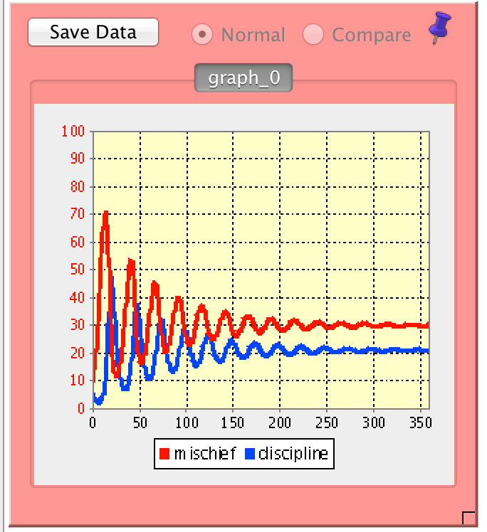
Why model? Mischievous students in a classroom
What does it look like?
The Dyadic Model
When teachers discipline students, mischief decreases
When student mischief increases, teacher discipline increases
This unfolds over time

Slide 10
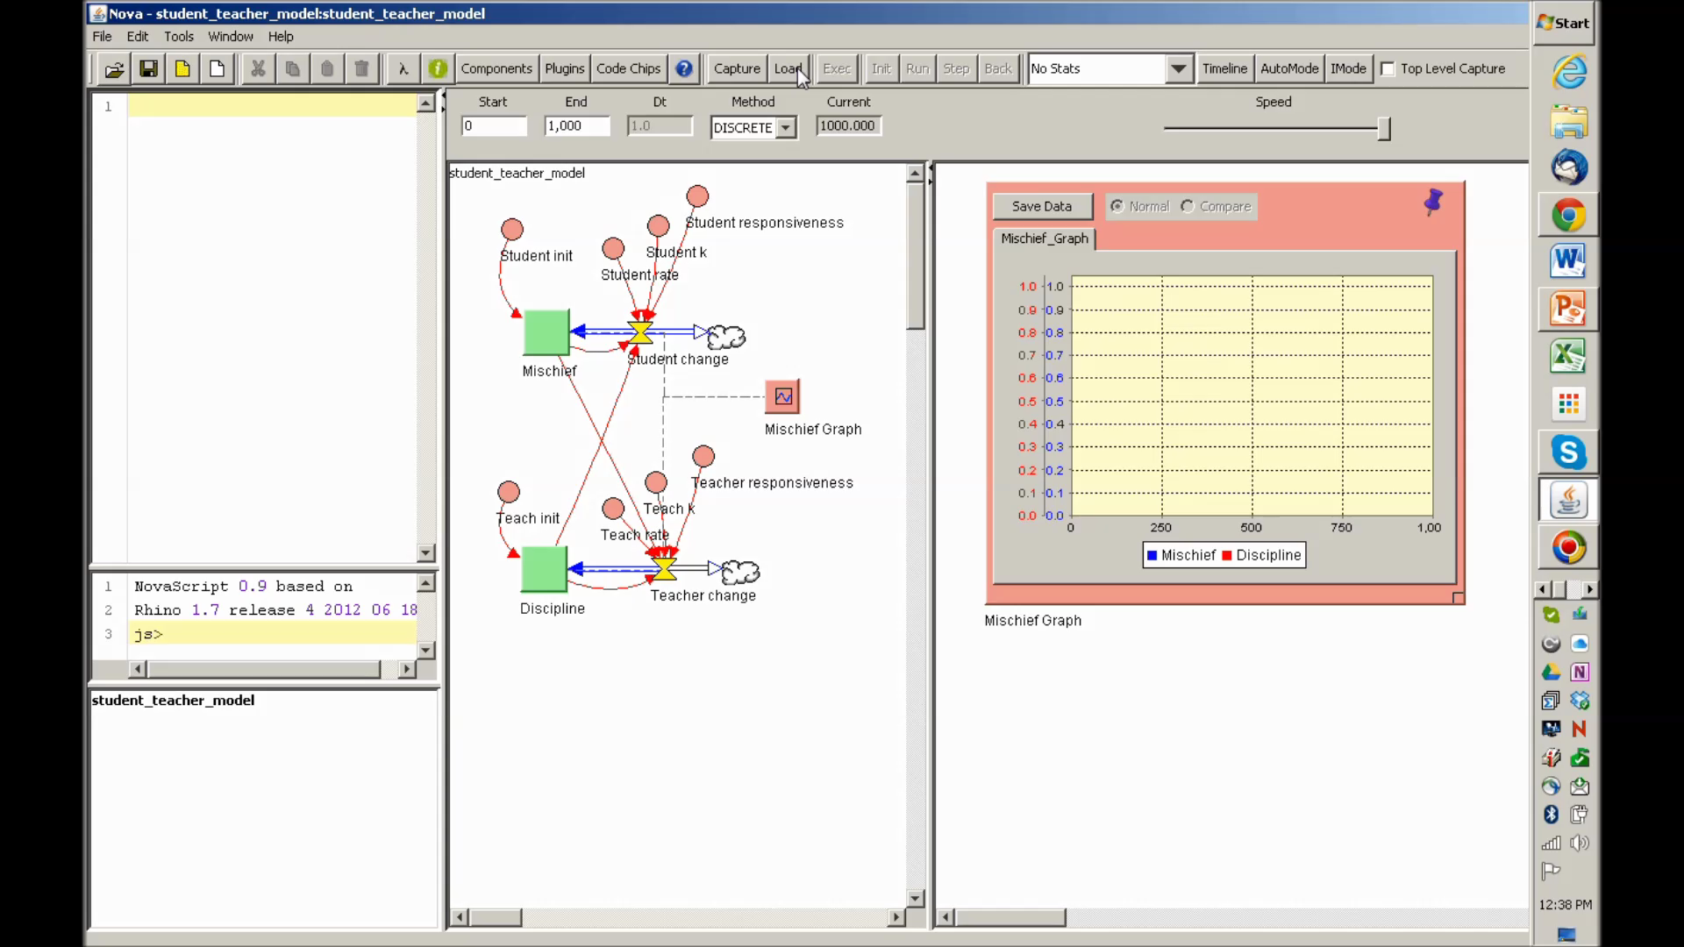
Why model? Mischievous students in a classroom
Basic model components:
Teacher initial, base and responsiveness
Student initial, base and responsiveness
Straightforward stock and flow model with output

Slide 11
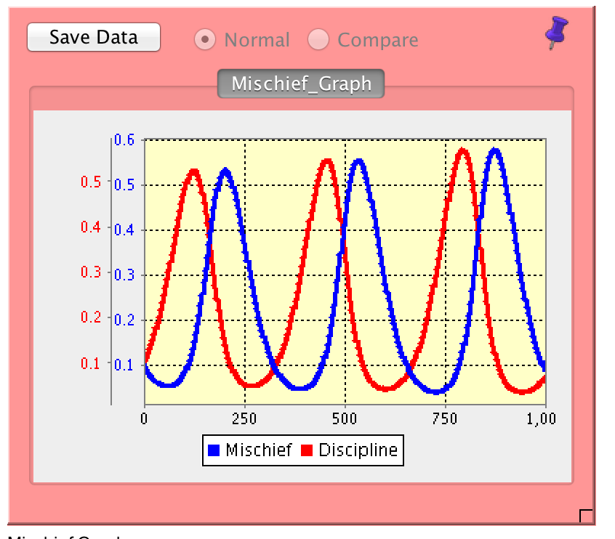
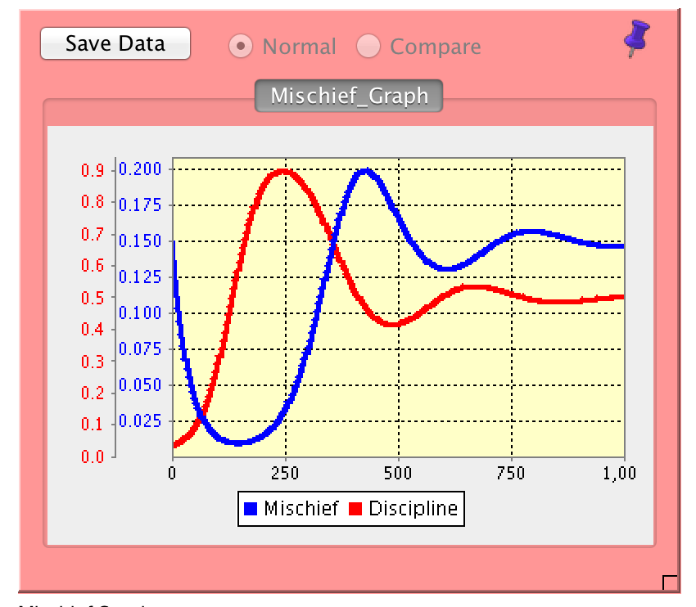
What would happen if . . .
How many different configurations would result in this?
Average teacher and student
Mischievous unresponsive student, low base teacher

Slide 12
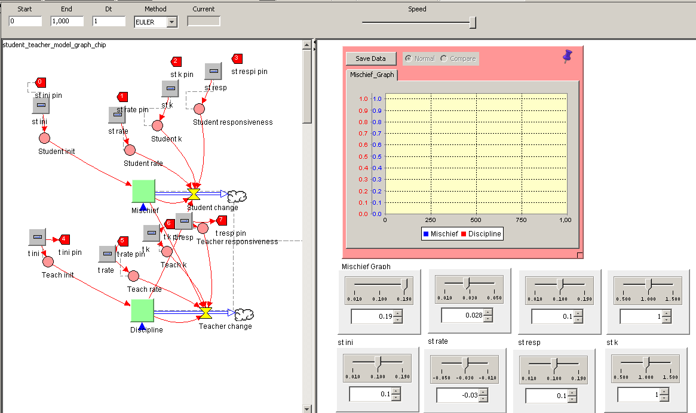
Developing scenarios
After the model is developed, I can add sliders or spinners
Critical combinations can be generated or Nova can be programmed

Slide 13
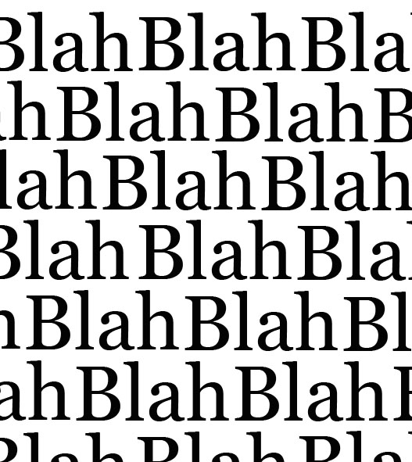
Why model?
Even very simple conceptual models that involve reciprocal interactions and unfold over time result in complex patterns
Multiple configurations result in the same pattern
Dynamic systems modeling provides tools to see what your data would look like if your theory were right

Slide 14
Gedanken experiments: Computational models generate data
The process of building the model forces you to be explicit
  Does the data generated meet your expectations?
Given expectations, how should the study be designed?
If the theory on which the model were based were correct, could you tell?
  What would the data look like?
  Could you eliminate plausible alternative processes?
  Could you distinguish different constellations resulting in identical outcomes?

Slide 15
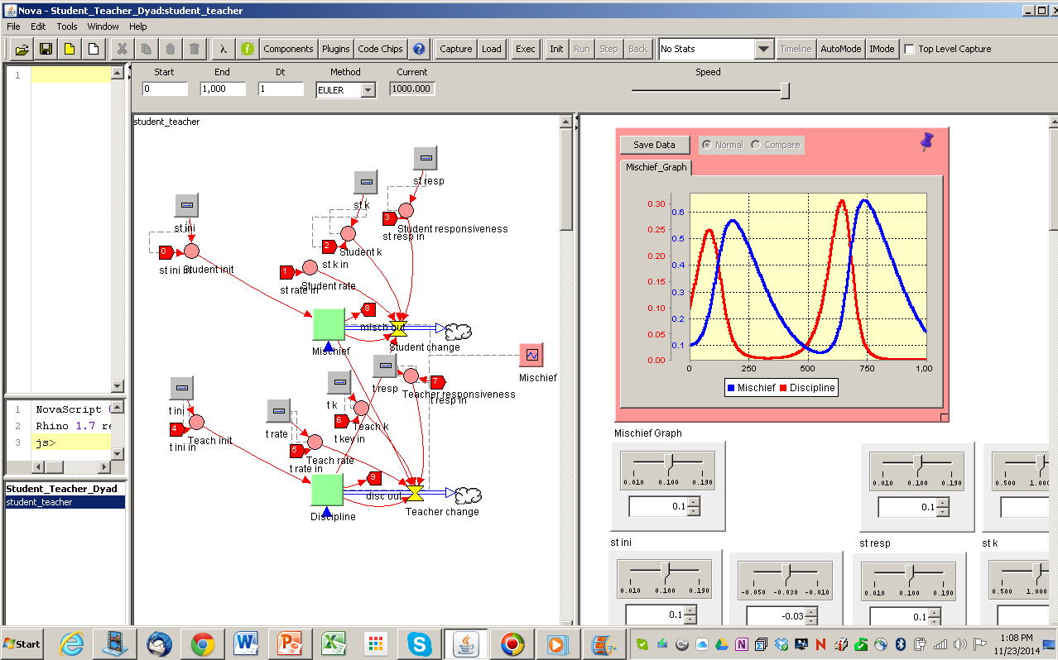
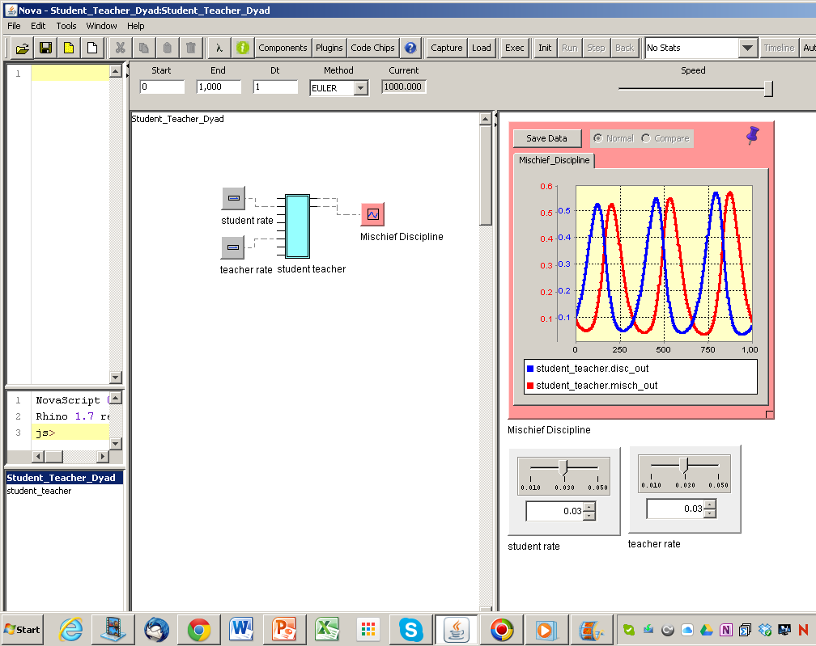
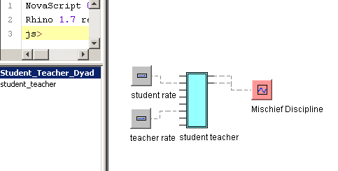
Nested models: Kids in a classroom

Slide 16
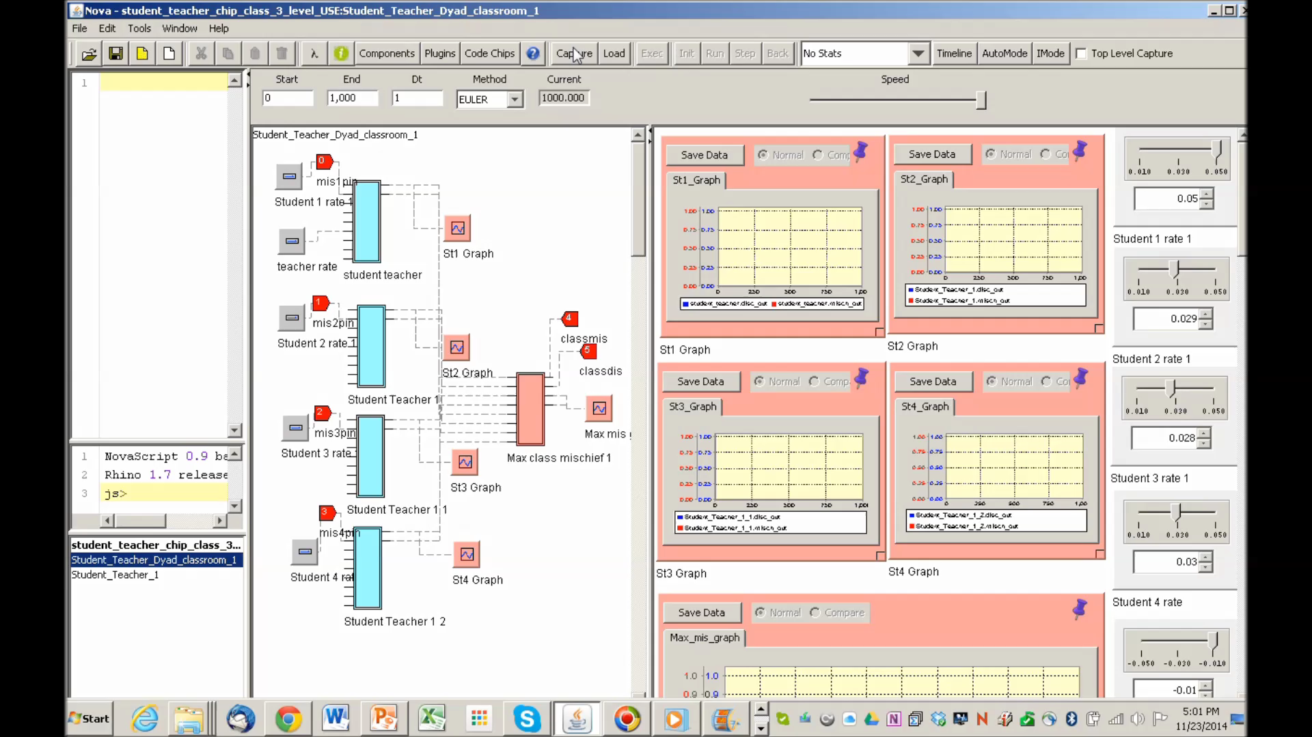
Nested models: Kids in a classroom
1 mischievous and 3 average students
Four capsules represent 4 students

Slide 17
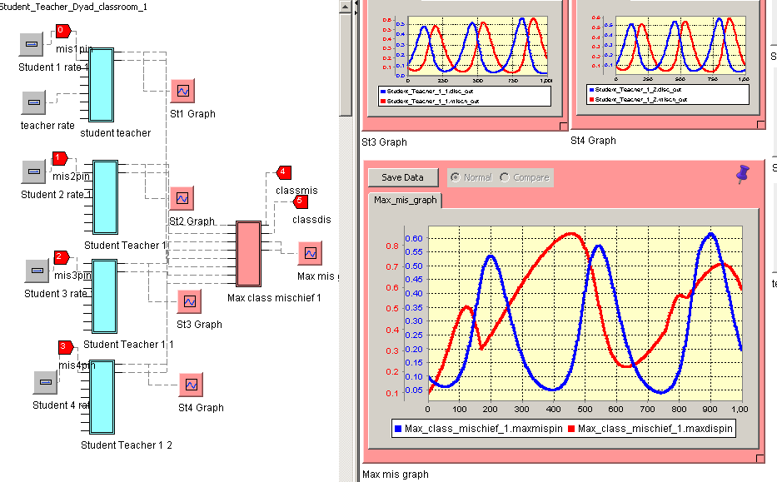
Nested models allow you to look at individual, dyadic, and classroom effects.

Slide 18
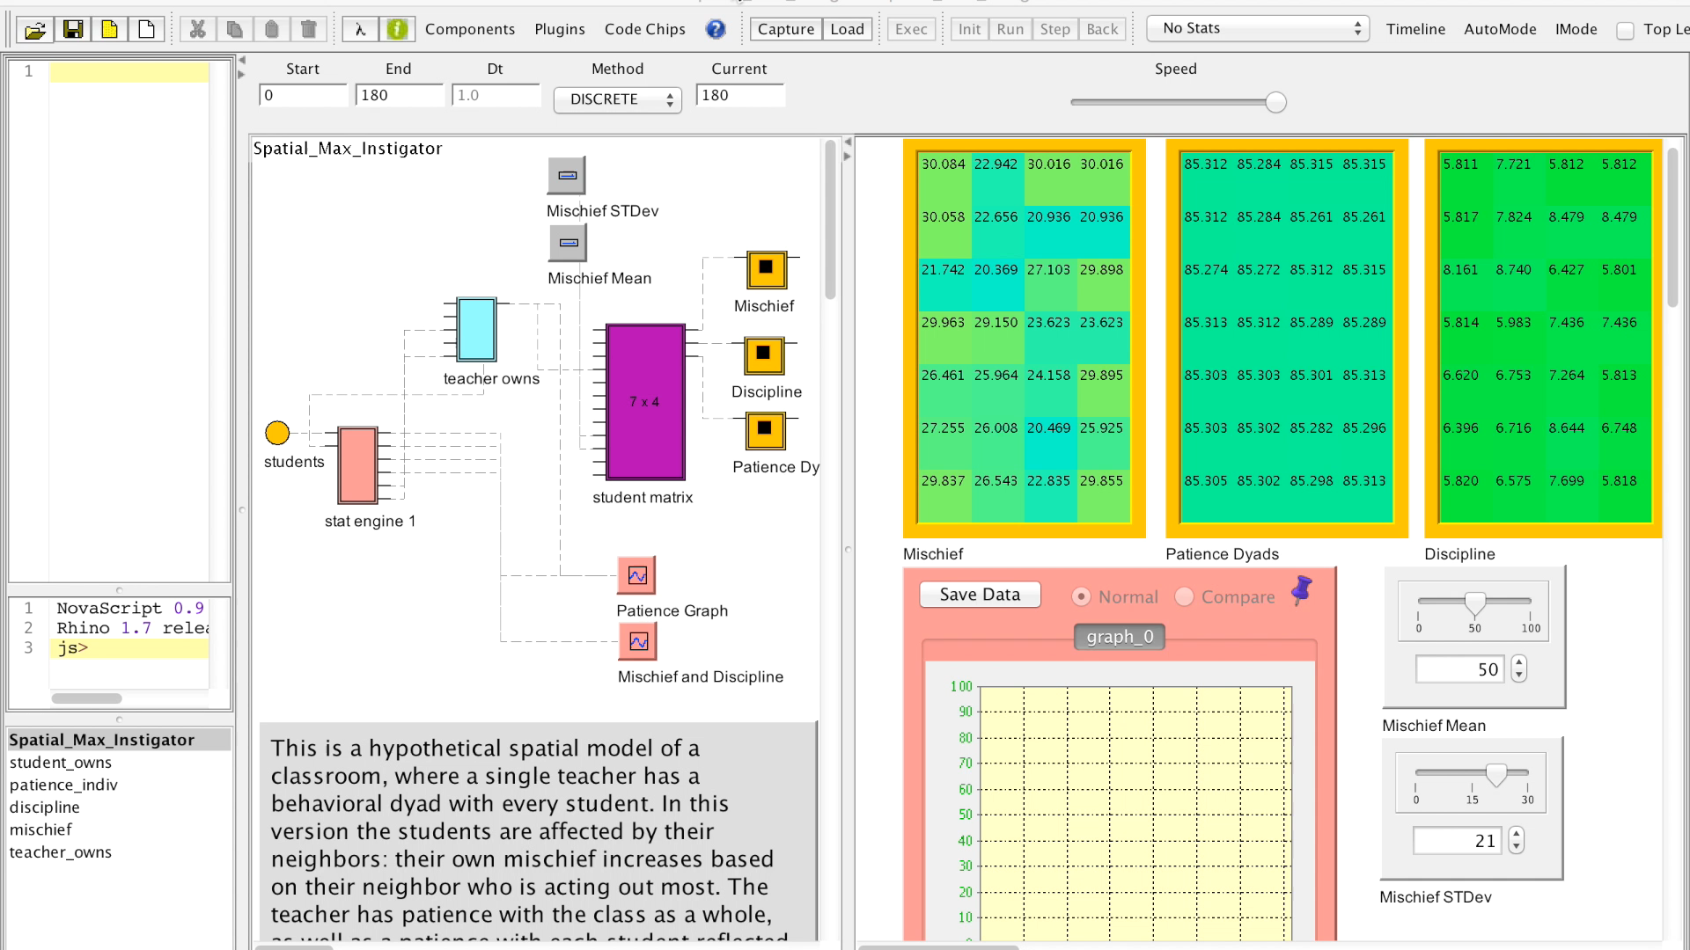
Chips can be configured spatially, so that each student influences the other and the teacher responds to individual and classroom characteristics

Slide 19
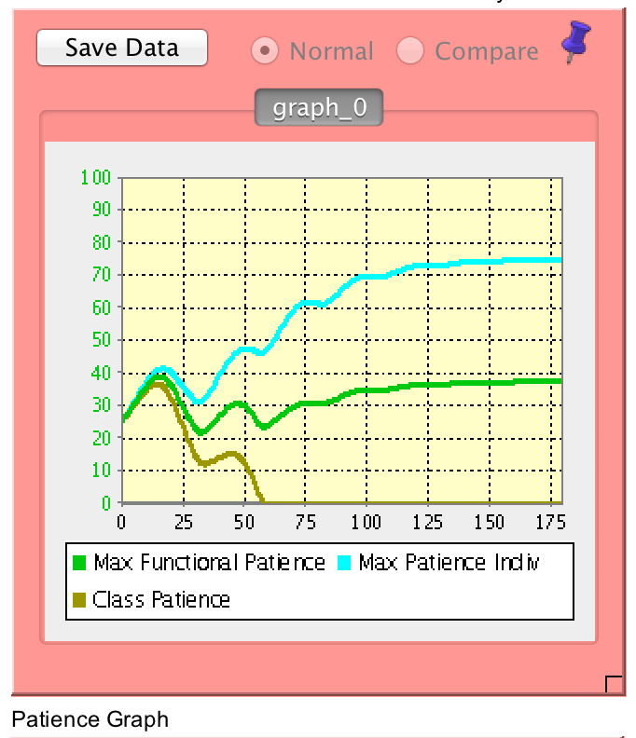
You can model individual dyads within the classroom
Teacher patience with student
Teacher functional patience with student
Teacher patience with class

Slide 20
Why is that cool? More complex models
You can take the aggregated classroom mischief and create a stock called ‘stress’ that decreases a stock called ‘patience’ that changes the teacher’s dyadic reactivity
You can create contagion effects so each student’s behavior changes depending on classroom context
  Contagion can be proximity based
You could create an agent based model where children move to find others like themselves and create pockets of mischief through contagion

Slide 21
Running simulations and outputting data
Nova has the capacity to automatically run through a range of possible values
Data can be viewed as:
  Graphs
  Tables
Data can be exported as csv or directly to R

Slide 22
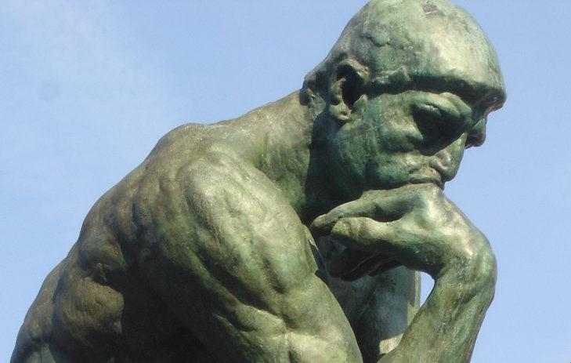
What do you do with this all this data?
Use it to develop and refine theories
Use it to design studies
Use it to refine analyses of existing data
Use it to test whether your data fits the theoretical model

Slide 23

www.novamodeler.com

Slide 24
The plan . . .
Develop three simple models to illustrate what systems modeling can teach us that is different from what statistics can
  Physical model
  Modeling using spreadsheets
Work with two models using Nova to illustrate why you might want to learn a more complex modeling tool
  Attachment and relationship satisfaction
  Dating market

Slide 25

A model of a model . . .
  This is an old story, but model leads to new insight
  Simple phenomenon hard to model well with statistics.
Lessons?
  Where you start matters
  Skill matters
  Each success leads to a an increased likelihood of future success
    Non-linear increase
    Current, not initial interaction with distance
  Where you are in the pack matters: people get in your way

Slide 26
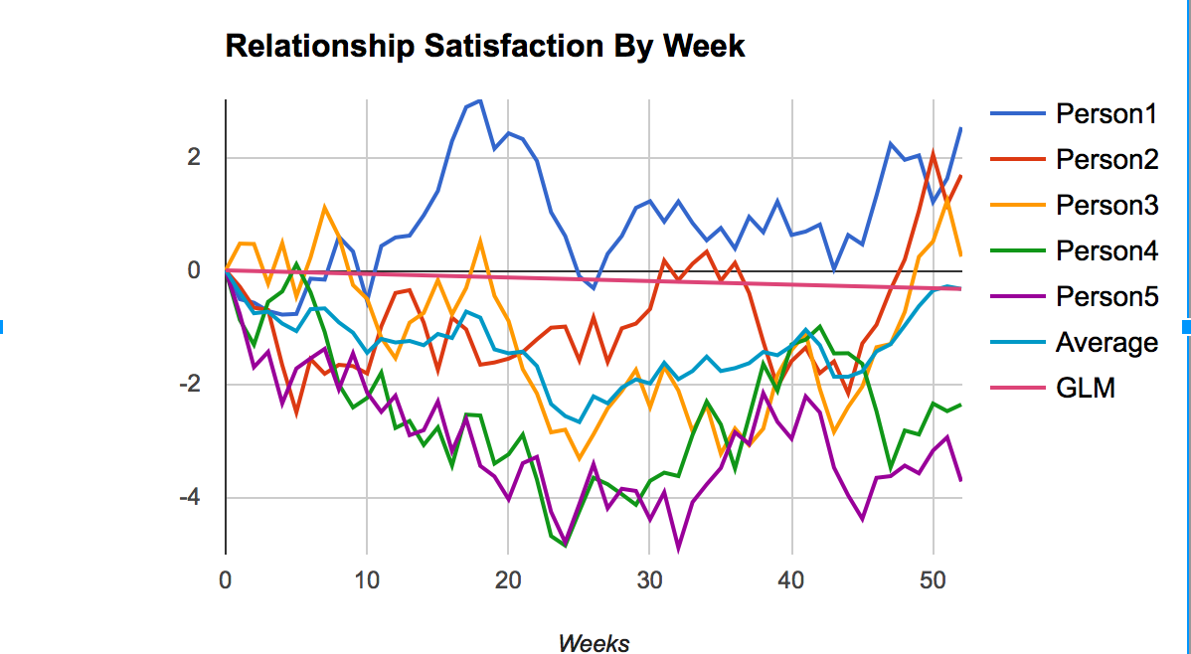
Statistical v. Dynamic Systems Models

Slide 27
Statistical v. Dynamic Systems Model
Model: All people start at the same place, their satisfaction varies randomly by week
Regression line is marked GLM
  Assumptions?
Average is mean of all models at each time interval
Fine a partner. Play with model – repeatedly draw new samples
Questions:
All the trajectories having a starting point of 0 (average satisfaction) and change each week. The function RAND() generates a random number between 0 and 1. Describe what the satisfaction value is determined by in words.
Every person’s weekly change is random. If change is random, it should average to 0. Why doesn’t everyone’s satisfaction hover around 0? How does this relate to our social class example?
What questions do the Average and the GLM plots address and how do those questions differ from the plots of individual relationship satisfaction?
We always talk about ‘error’ in statistics. In the graph, what is the error?
Go to Google Drive (INSERT URL)
Download your own copy

Slide 28
Playing with Toys: Build the Trashcan Model
Write a story: What happened?
Rapid prototyping:
  Individual differ in their starting place
  Individuals differ in their skill
  The closer they are to the trashcan, the more likely they are succeed
  The more skilled they are the more likely they are to succeed
Turn that story into an equation
  To enter an equation: =equation
  =Random(): Produces a random number from 0-1
  =If(condition,value if true, value if false)
  Distance is from 0-20’
Make a copy of the Course of Relationships sheet
Modify Person 1-5

Slide 29
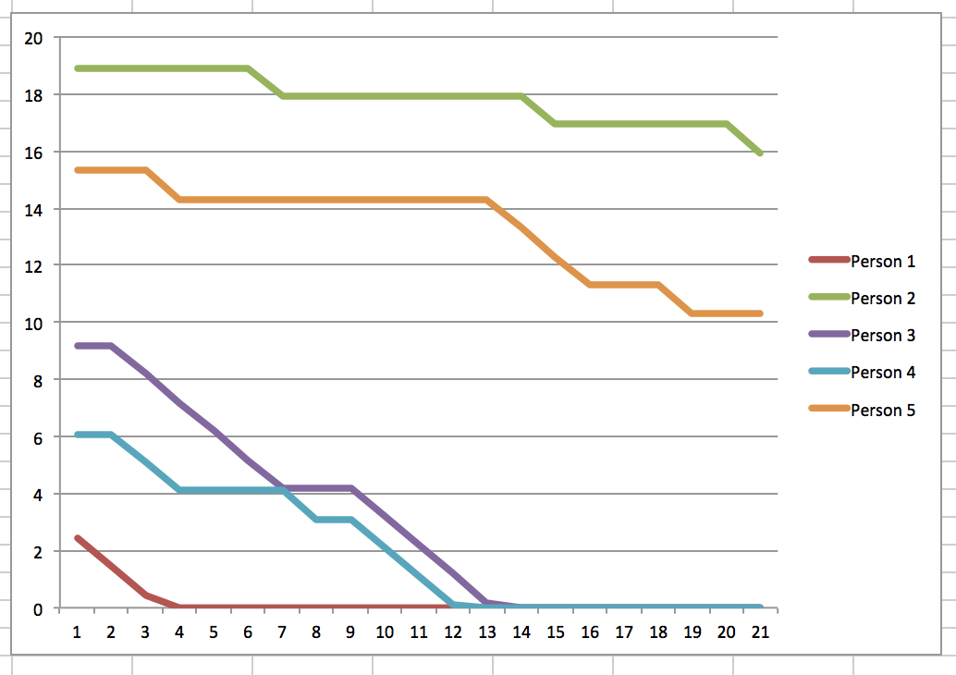
One minute essays: Why Bother?
By forcing myself to turn my story into an equation, I learned . . .
How would you improve the model?
How could you use the model?
What about floor/ceiling effects?
Making theory explicit
Making predictions of theory explicit
Testing ideal cases

Slide 30
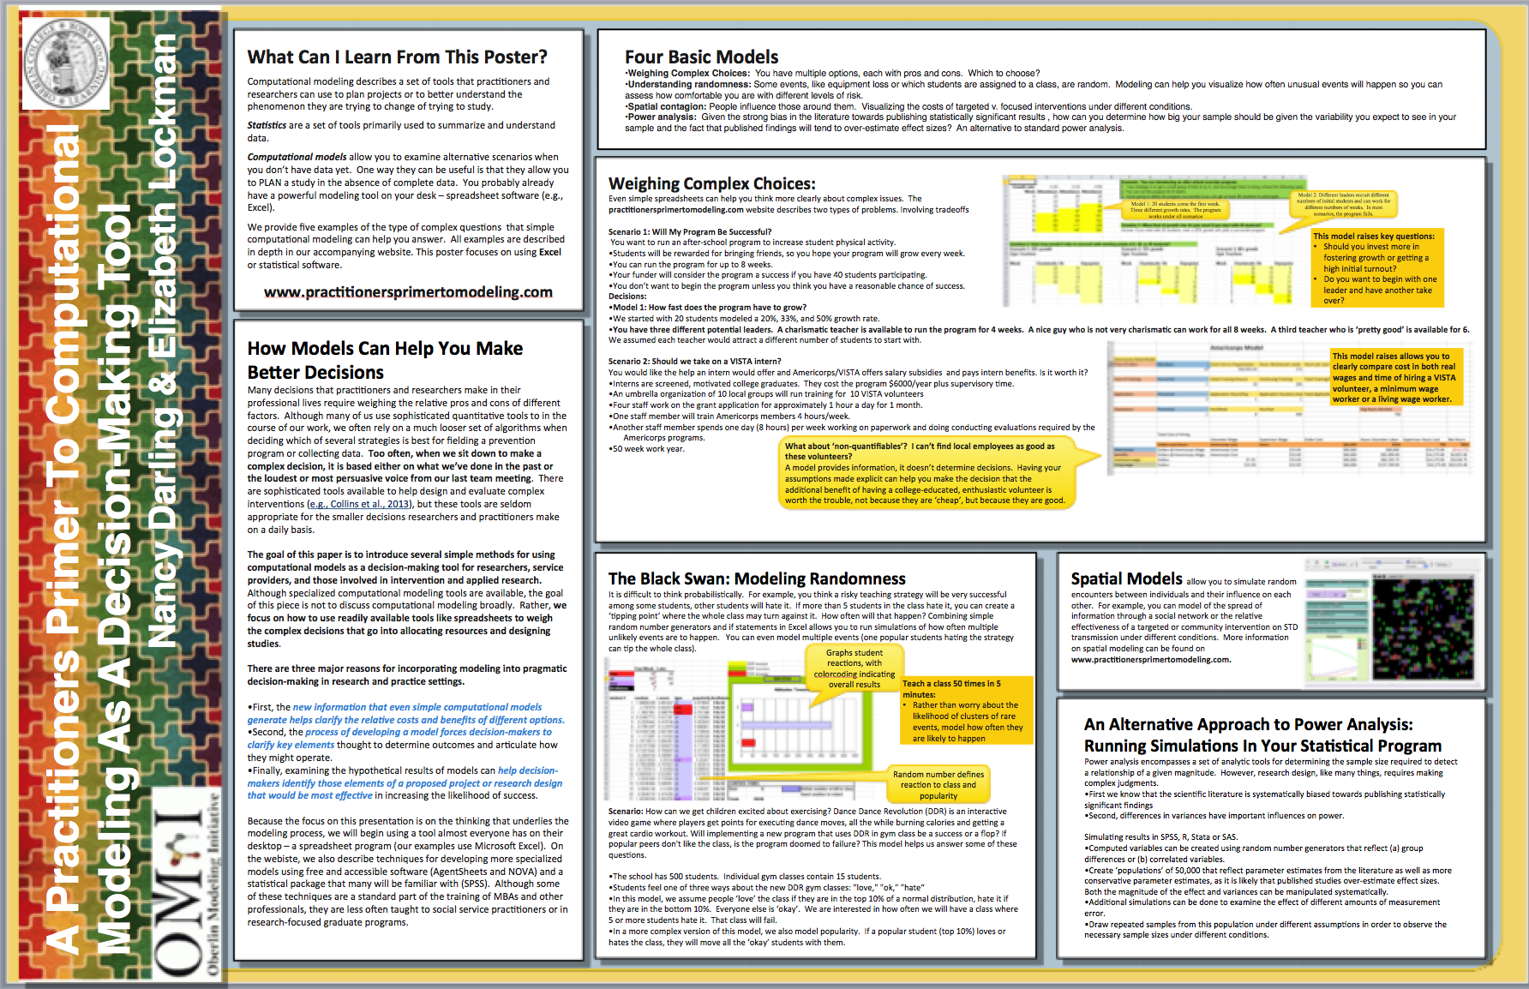
https://sites.google.com/a/oberlin.edu/a-practioner-s-primer-in-computational-modeling/

Slide 31
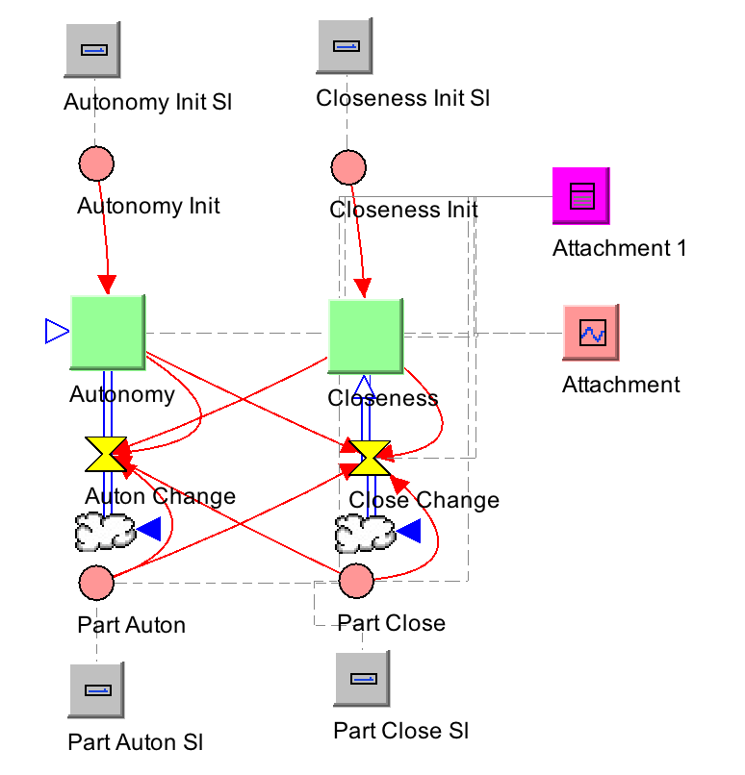
Playing with Toy Models: Relationships http://nova.oberlin.edu/novaol/nancy/Individual_Attachment_2t/Individual Model 2t
The characters:
  Closeness (mine and my partners) – I like you and want you closer
    I’m letting you in
  Autonomy – I am pushing you away
    I’m keeping you out
The plot:
  I like people who like me: If you are more close than I am, my closeness goes up
  I’m uncomfortable with people who crowd me: If you are less autonomous than I am, my autonomy goes up
The grammar:
  Simplistically:
    Autonomy: (me-them)*.01
    Closeness up: (me-them)*-.01
  Somewhat more nuanced:
    Autonomy: (Autonomy-Part_Auton)*.01+(Closeness-Part_Close)*-.005-.5
    Closeness: (Closeness-Part_Close)*-.01+(Autonomy-Part_Auton)*-.005+.5
It’s called a ‘dynamic systems’ model because it changes over time
Notes:
Show them this in Nova

Slide 32
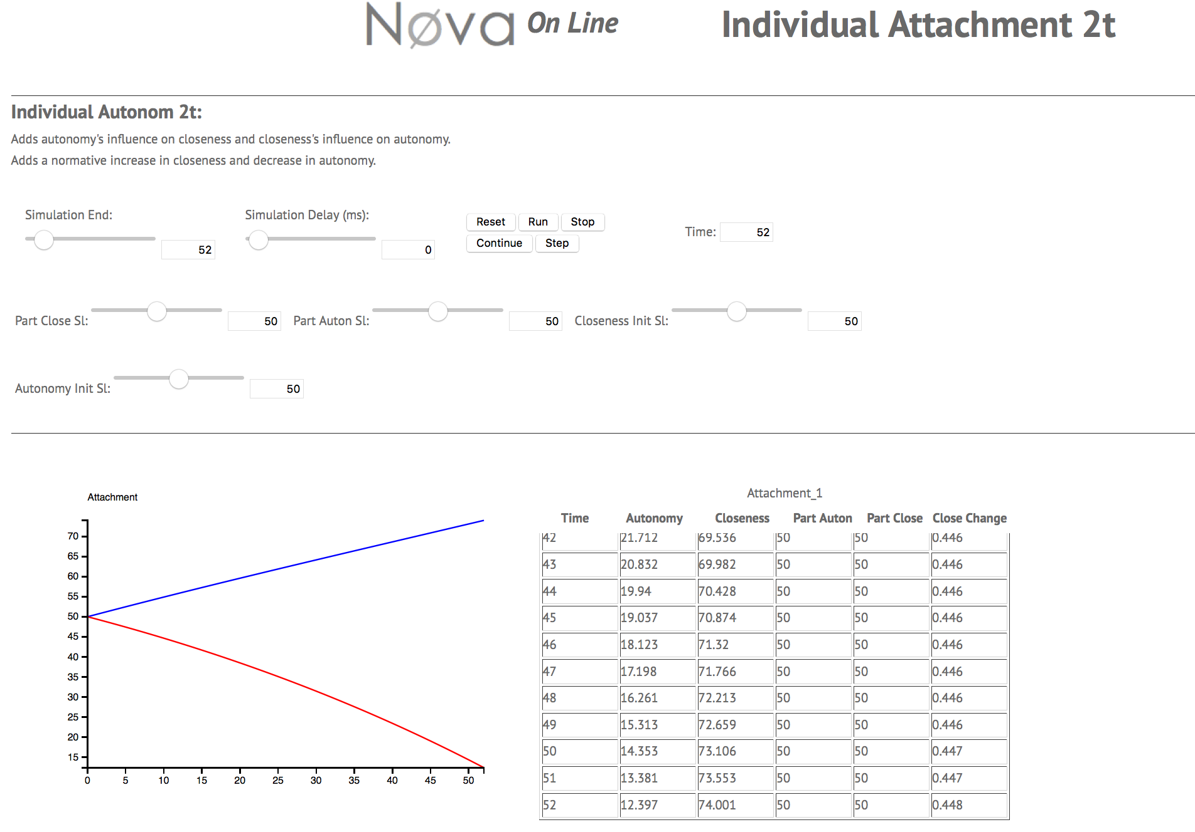
Playing with Toy Models: Relationships http://nova.oberlin.edu/novaol/nancy/Individual_Attachment_2t/Individual Model 2t
Individual reacting to ‘partner’: 4 variables
Blue: Closeness
Red: Autonomy
Four pure types:
  Hi/lo closeness and autonomy
Pick one and play with model: What kind of partner produces positive/negative trajectories?
Notes:
Show them this in Nova
Developed by my students: serious issues

Slide 33
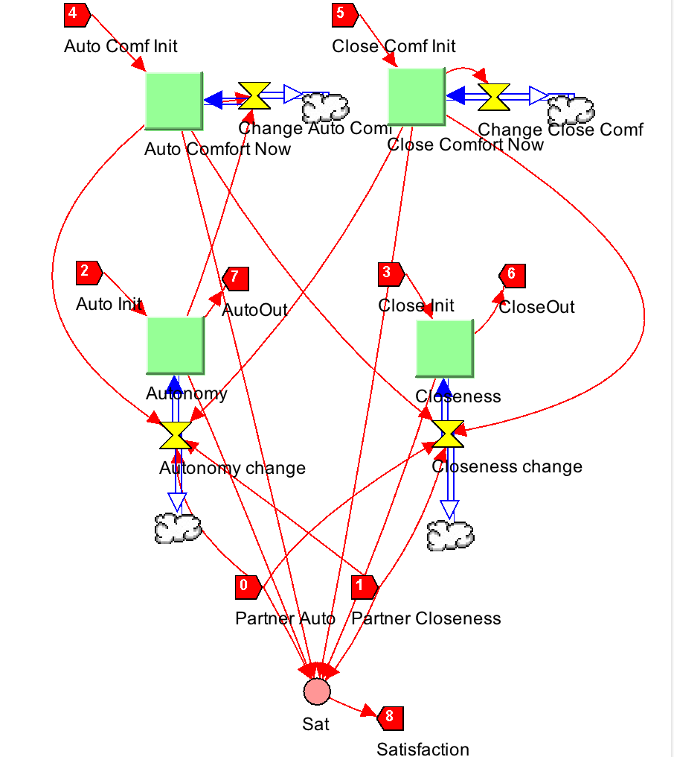
Playing with Toy Models: DYADIC Relationships http://nova.oberlin.edu/novaol/nancy/Dyad_model_5/
Much more complex model:
  Ideal comfort/autonomy, which changes with time
  Current c/a, which changes dependent on initial, partner
  Relationship satisfaction, which varies with distance of current with ideal
Notes:
Show them this in Nova

Slide 34
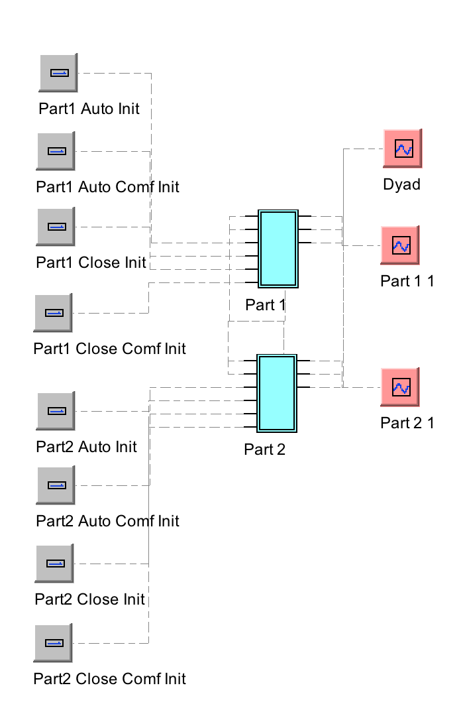
Playing with Toy Models: DYADIC Relationships http://nova.oberlin.edu/novaol/nancy/Dyad_model_5/
Notes:
Show them this in Nova

Slide 35
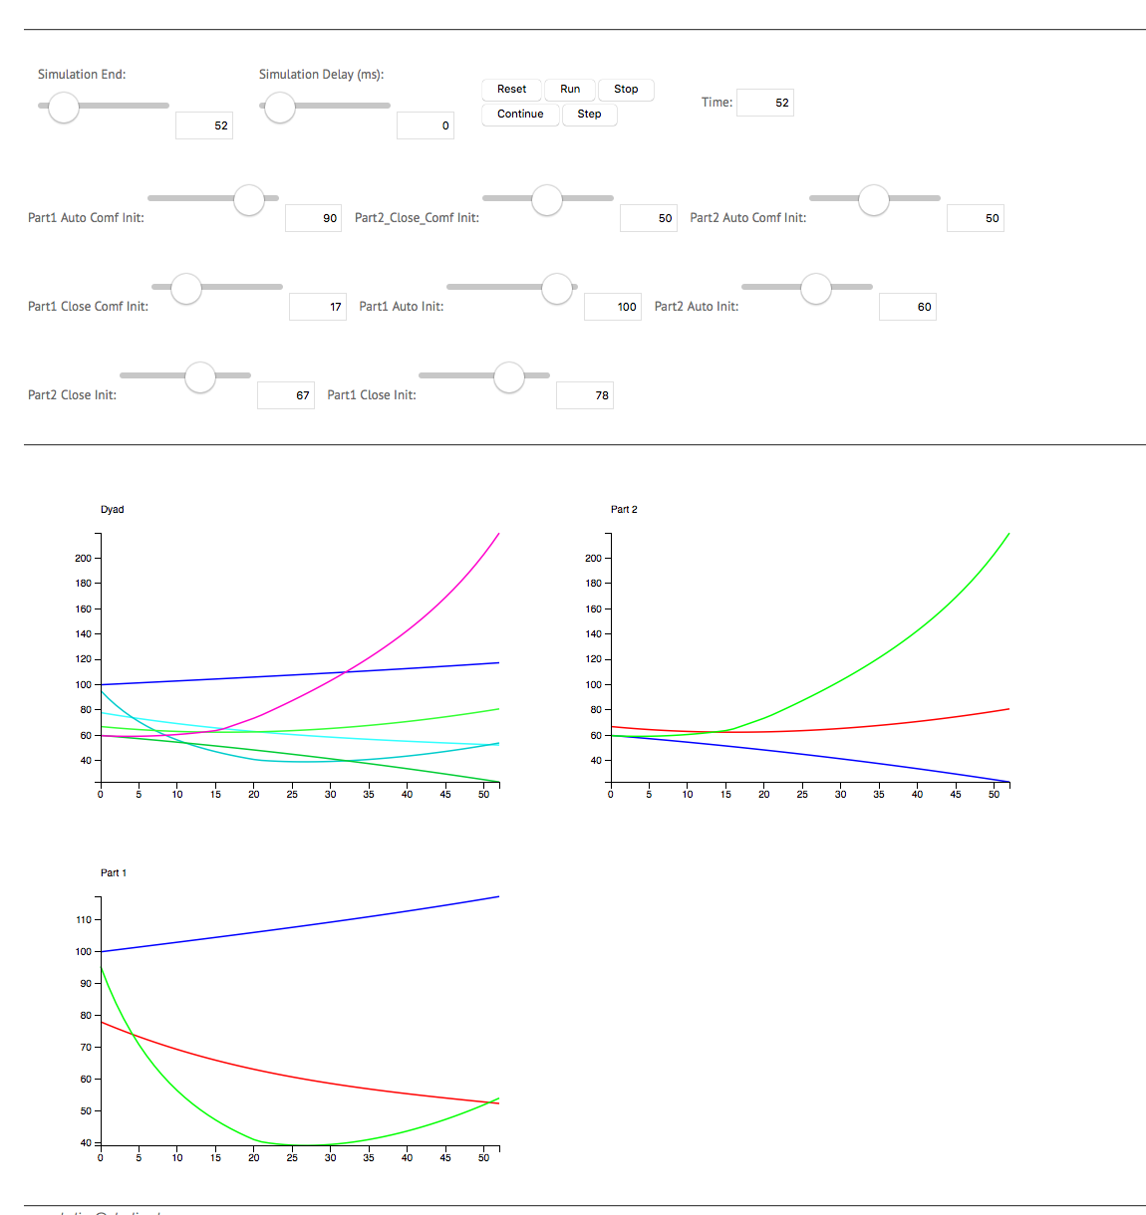
Playing with Toy Models: DYADIC Relationships http://nova.oberlin.edu/novaol/nancy/Dyad_model_5/
Poor labels: Infer from initial levels
Graphs:
  Dyad (Autonomy/Closeness/Satisfaction of both partners)
  Each partner separately
Can you find happy pairings?
What do you notice about these graphs???
Why?
Notes:
Show them this in Nova

Slide 36
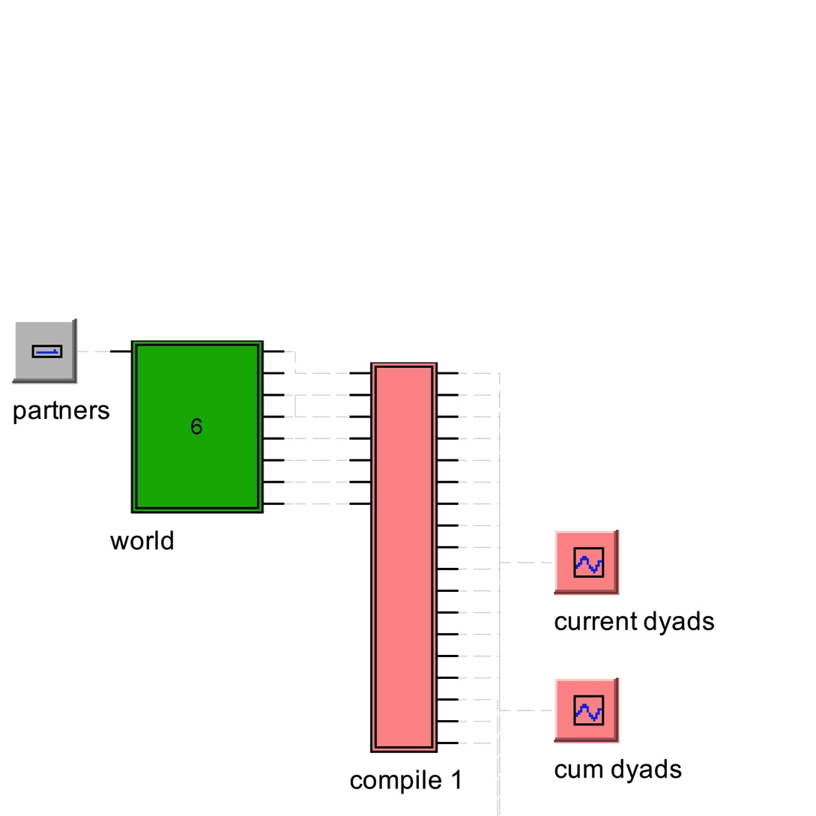
Not a model dyad, but a model world
This world is populated by 1000 people
They are anxious, avoidant, or secure
They randomly meet, they stay together until one gets unhappy, then they break up, recover, and find a new partner
What does this world look like?

Slide 37
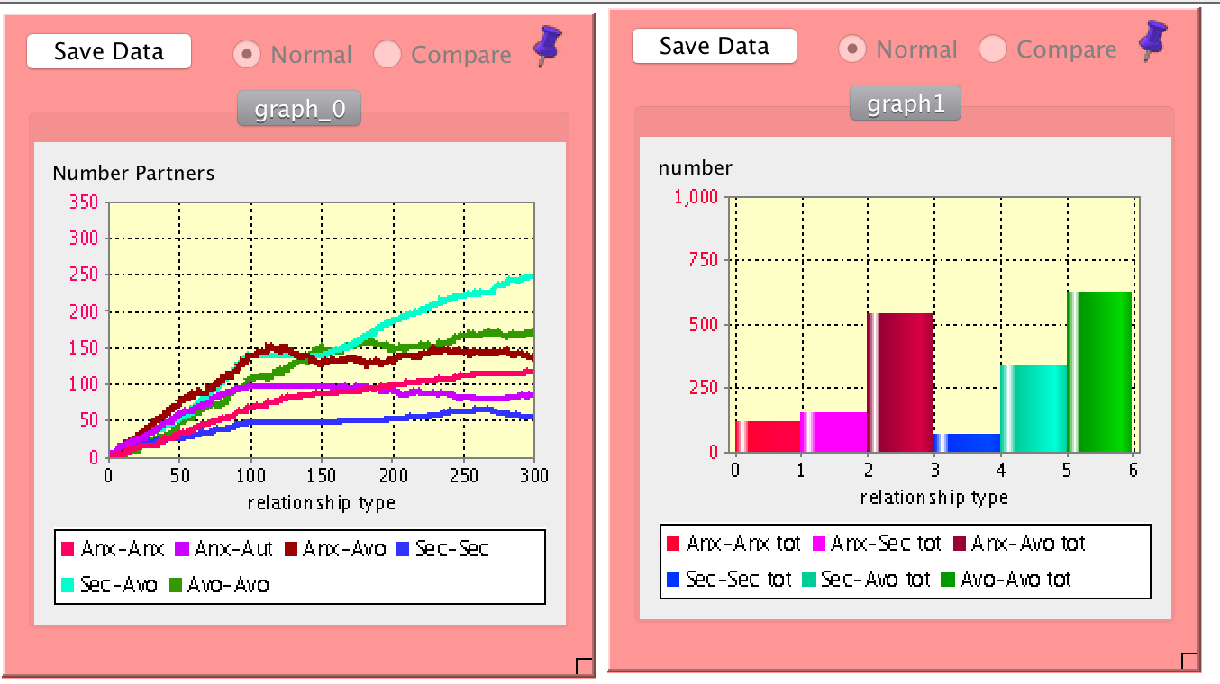
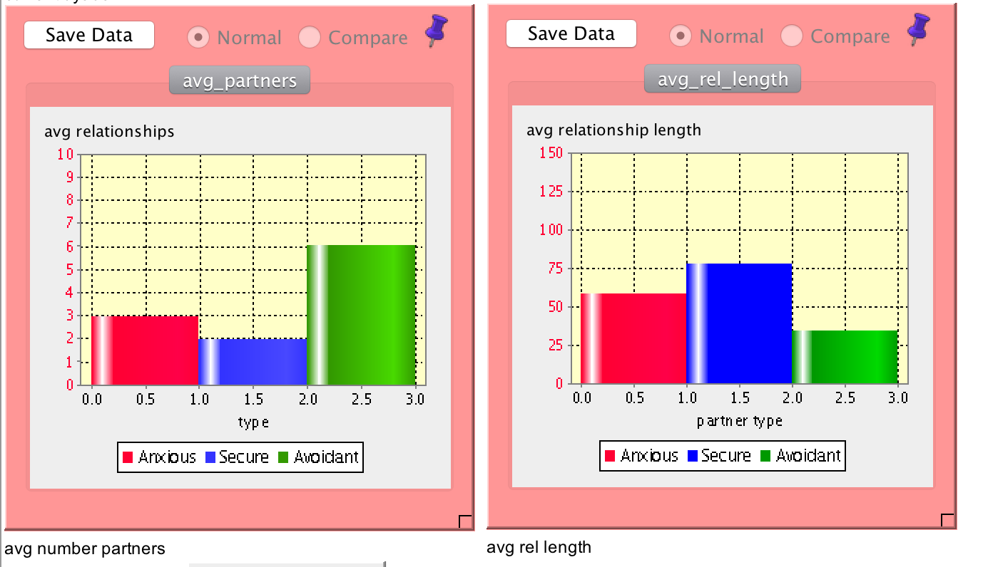
More Toys: Marriage Market
Over time v. cumulative pairings
The proportion you sample
cross-sectionally differs from
Population (ex: Secure:Avoidant)
What are the average number
of relationships different types
of people might have in a given time?
How long do relationships last for
different types of people?

Slide 38
Toys to Research
This model was developed by my
undergraduates in an 8 week course.
Currently deterministic: people paired
Randomly, but each dyad type assumed
to have a known length
Research in progress: Why do we so often see pairings of Avoidant and Secure partners?
Refining the dyadic relationship model shown
Previously. Each type will have a central
tendency that autonomy and closeness vary
Around. Pairings will occur randomly and run
their course until relationship satisfaction falls
below critical.
Will match the results of the model to information from the
literature on distributions of attachment pairings in romantic dyads.

Slide 39
Is modeling a research or a teaching tool?
Theory building and refinement
Sensitivity analysis and research design
If your theory were right, what would the data look like?
  Run model iteratively, collect the data, analyze, compare to empirical data. That is a direct test of model fit.
Test adequacy of standard statistical models to test the theory.
Identify key sub-populations and run models for those groups, using the data generated to better identify subgroups in empirical data
Do person-centered analysis on simulations to help identify different underlying causes that result in the same set of outcomes
Providing support for theories and hypotheses where experiments are impractical:
YES!

Slide 40
Modeling Is the Friend of Theory
The process of building the model forces you to be explicit
Helps you design rigorous tests of theory
An additional quantitative tool

Slide 41
Modeling
What models are: A model of a model
How dynamic systems models differ from statistical models: A random walk
Using models to make theory explicit: Dance Dance Revolution
Understanding randomness: Tipping
Modeling complex processes: Attachment
Modeling populations: Marriage markets

